Slide 1
Parallel Matrix-Vector Multiplication
Authors: Patrick Boronski, Rodolfo Croes

Slide 2
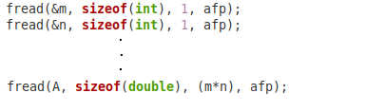
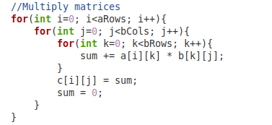

The Code
File I/O
Serial Multiplication

Slide 3
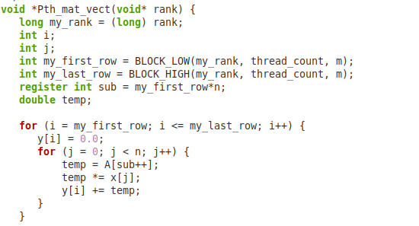
The Code (continued)
The Macros
Parallel Code
Output Format

Slide 4
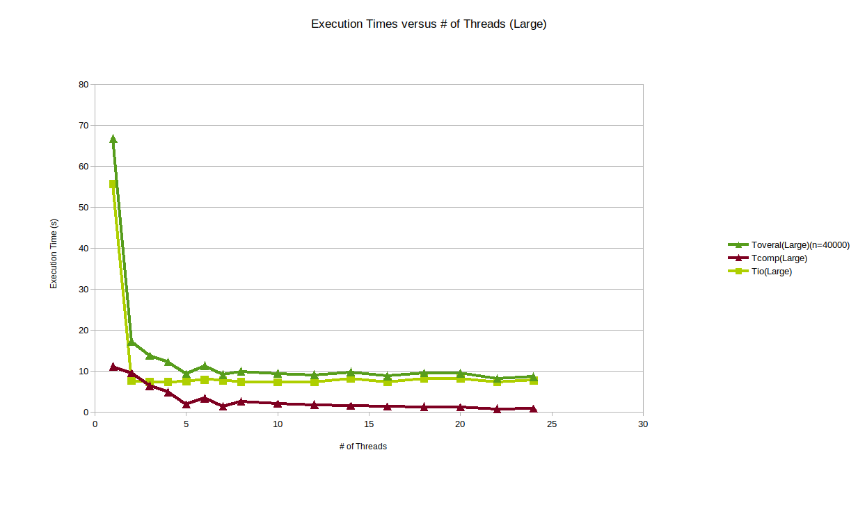
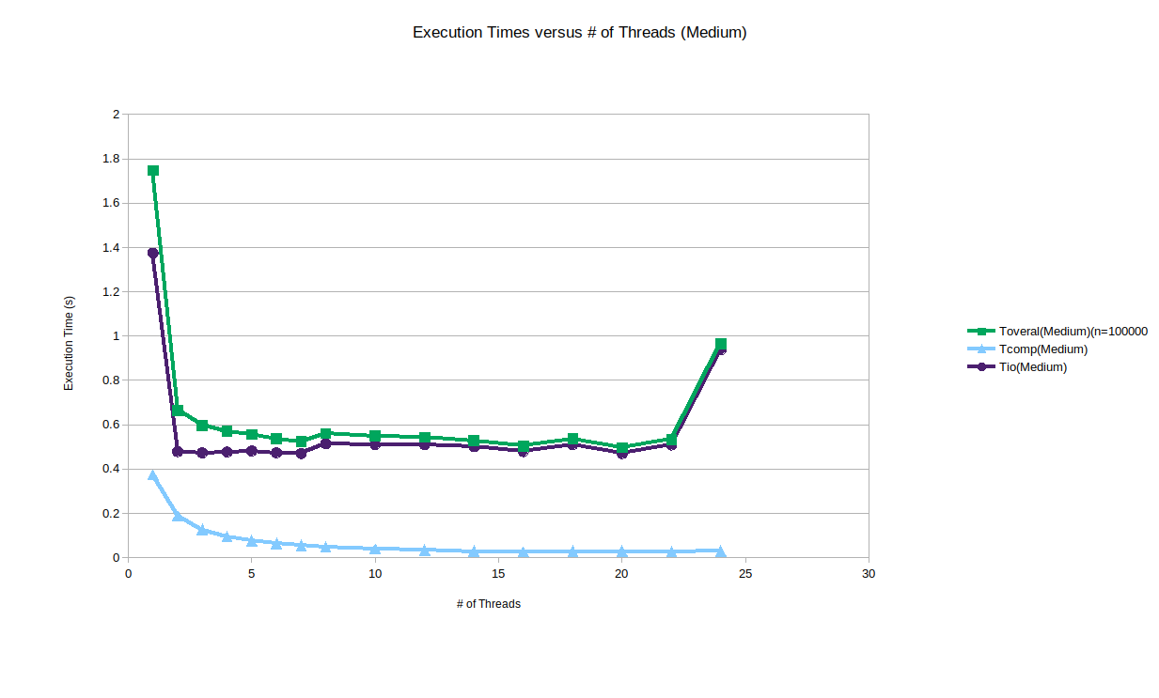
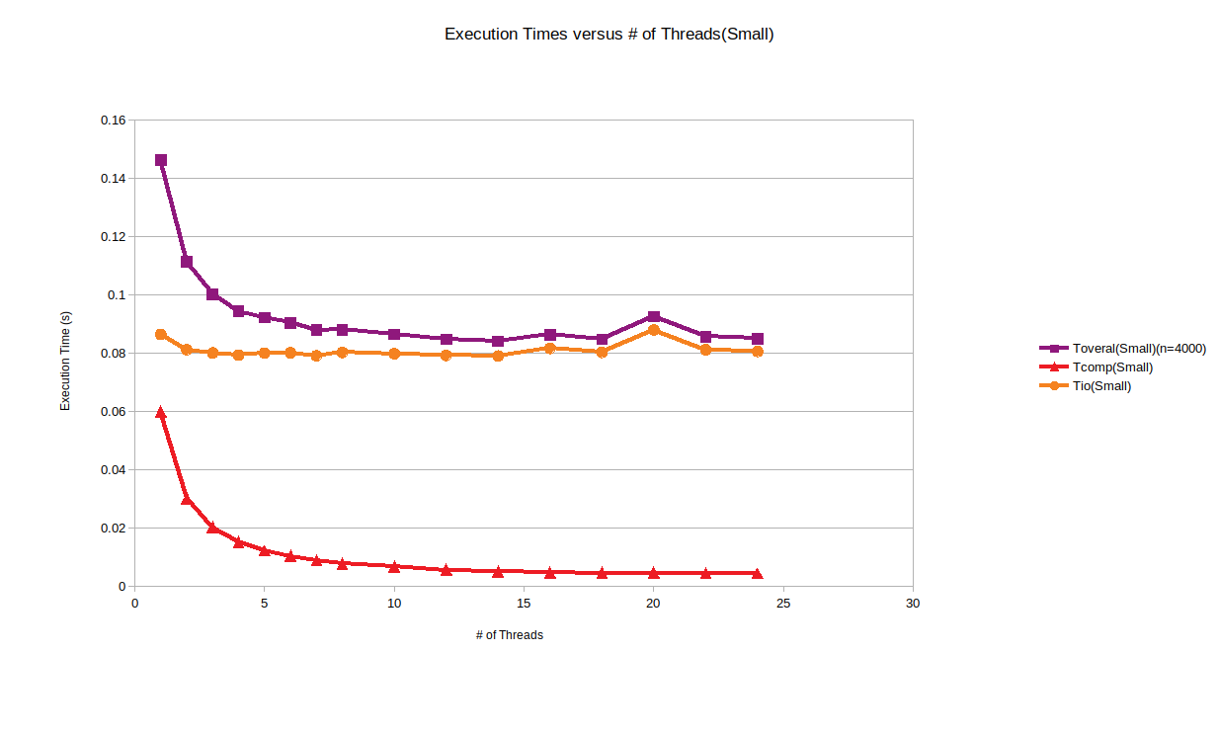
The Data (Execution Times)

Slide 5
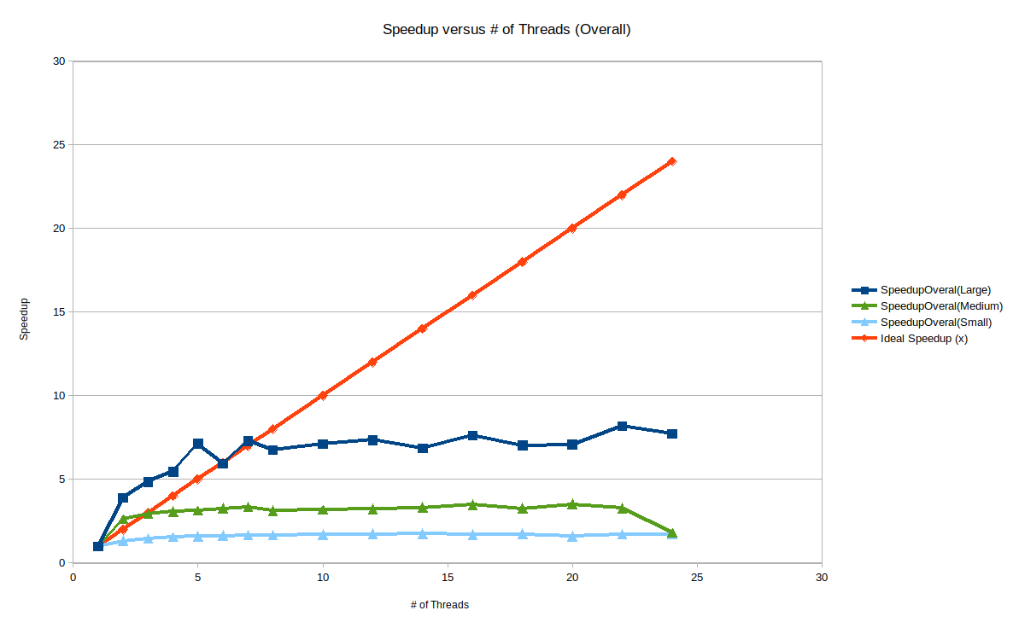
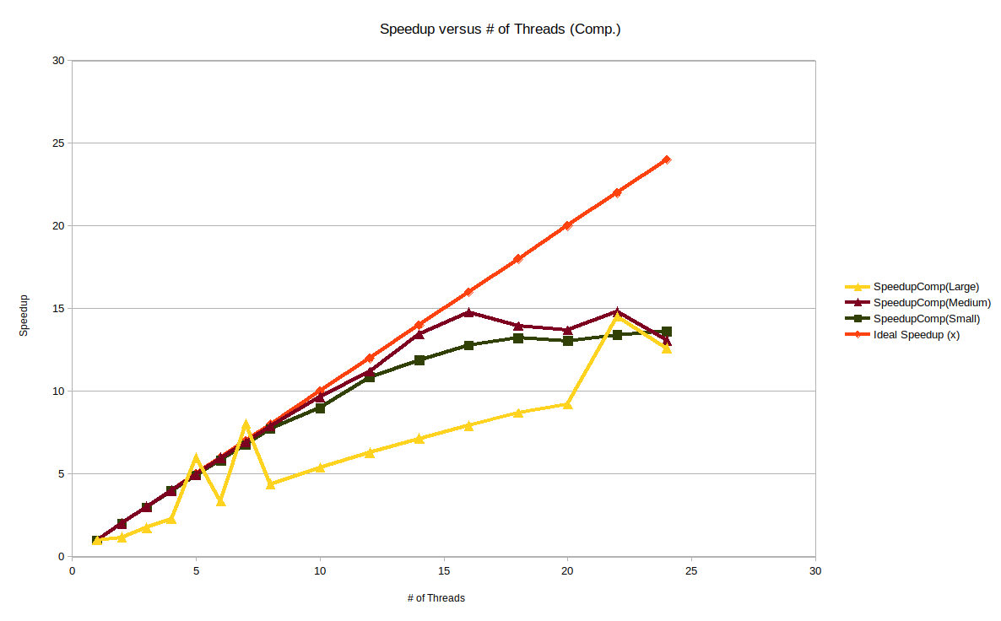
The Data (Speedup)

Slide 6
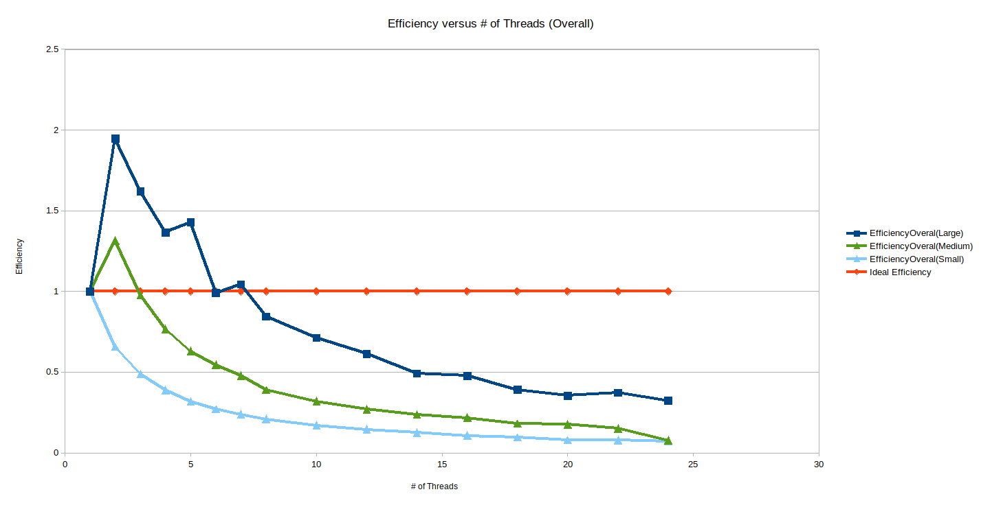
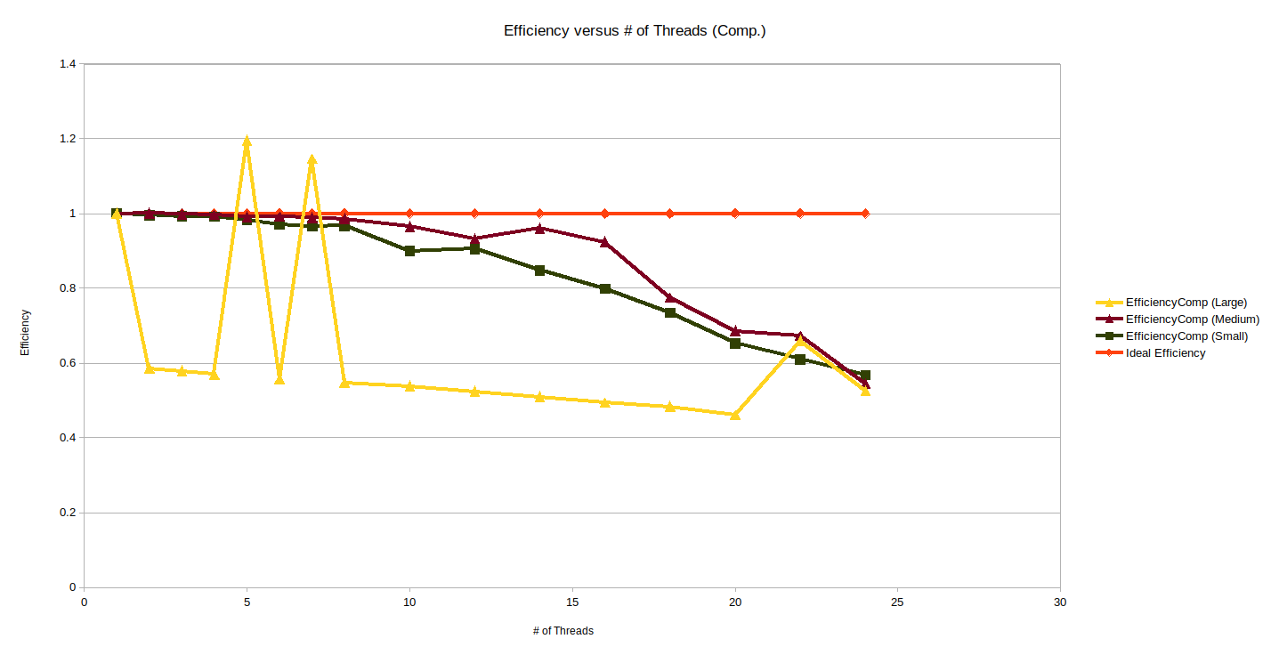
The Data (Efficiency)

Slide 7
Conclusion

Slide 8
References
R. Robey and Y. Zamora, Parallel and High Performance Computing, 1st ed., vol. 1. Shelter Island, NY: Manning Publications, 2020
M. J. Quinn, Parallel programming in C with MPI and OpenMP. Boston, Mass.: McGraw-Hill, 2008.
S. Ristov, R. Prodan, M. Gusev, and K. Skala, “Superlinear Speedup in HPC Systems:why and when?,” Annals of Computer Science and Information Systems, 2016. [Online]. Available: https://annals-csis.org/Volume_8/pliks/pliks/498.pdf. [Accessed: 24-Apr-2020].

